Slide 1
Github: Active no of accounts, Month wise activities of user
By:
Harish kumar G (171046017)
Athish M (171046030)
Under the guidance of
Deepak Rao

Slide 2
Introduction
Github is an open source code hosting platform for version control and collaboration. It lets you and others work together on projects from all over the world.

Slide 3
Scope
GitHub reports have almost 20 million users and about 50 million repositories, making it the largest host of source code in the world.
The scope of the project is to find the active users and their activity.

Slide 4
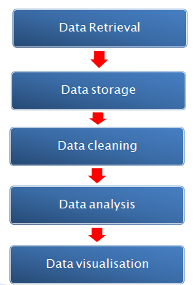
Data Flow Diagram

Slide 5
Software Requirements
Github Api’s
Python
Matplotlib
Hardware Requirements
Processor:i5
Ram:4gb
HDD:500gb

Slide 6
Data Extraction
We used this github api ‘GET /users’ to get the user name by their user IDs
Next, ‘GET /users/:username/repos’ was used to get the repositories of the particular user
‘GET /repos/:owner/:repo/stats/participation’ was used to get the commit details of that repositories

Slide 7
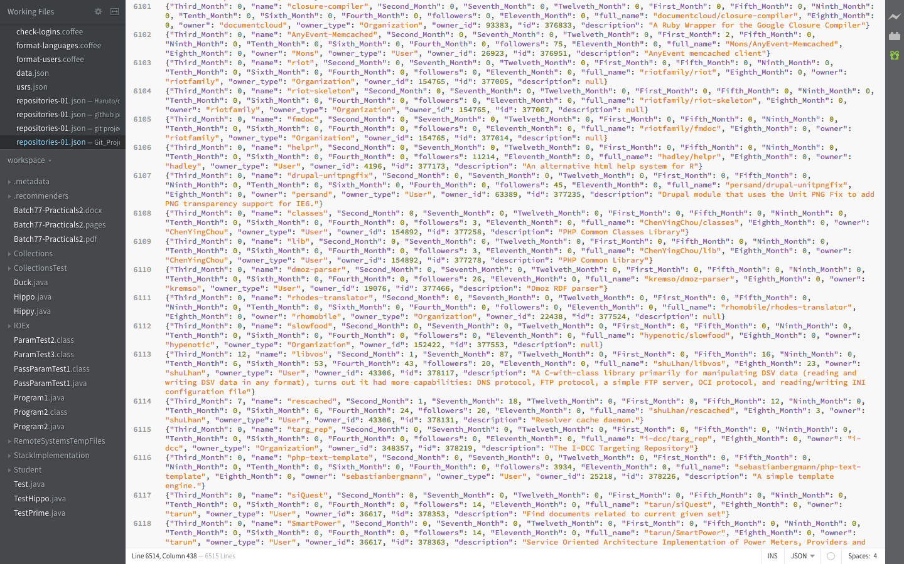

Slide 8
Data Cleaning
Csv file

Slide 9
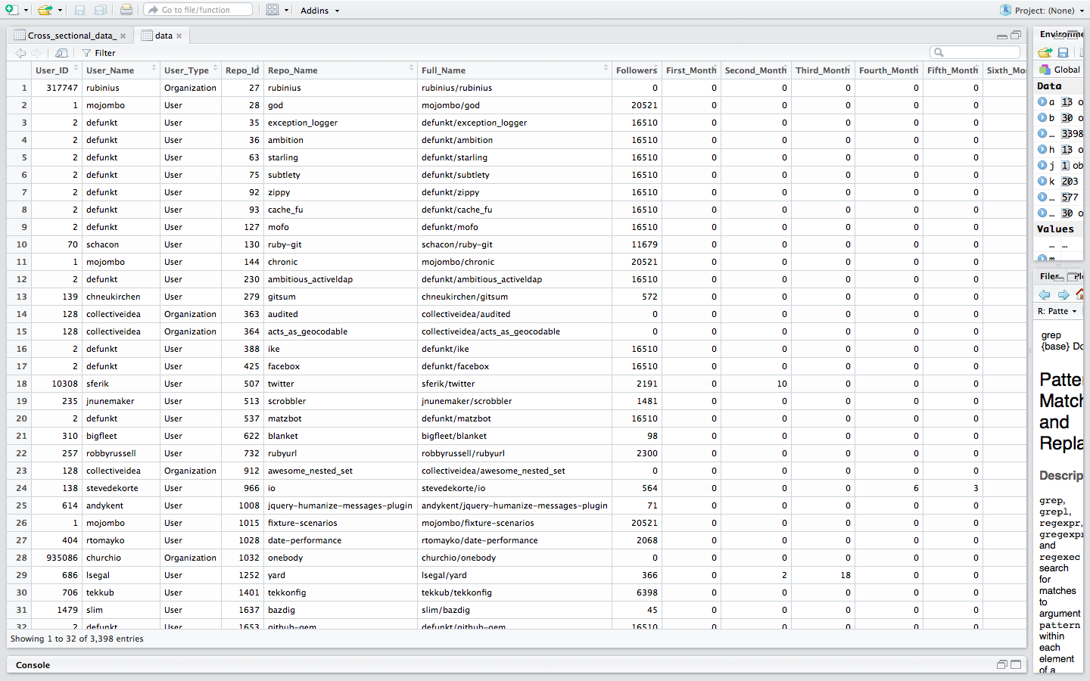

Slide 10
Data Visualization
Pie-chart
Colourmap

Slide 11
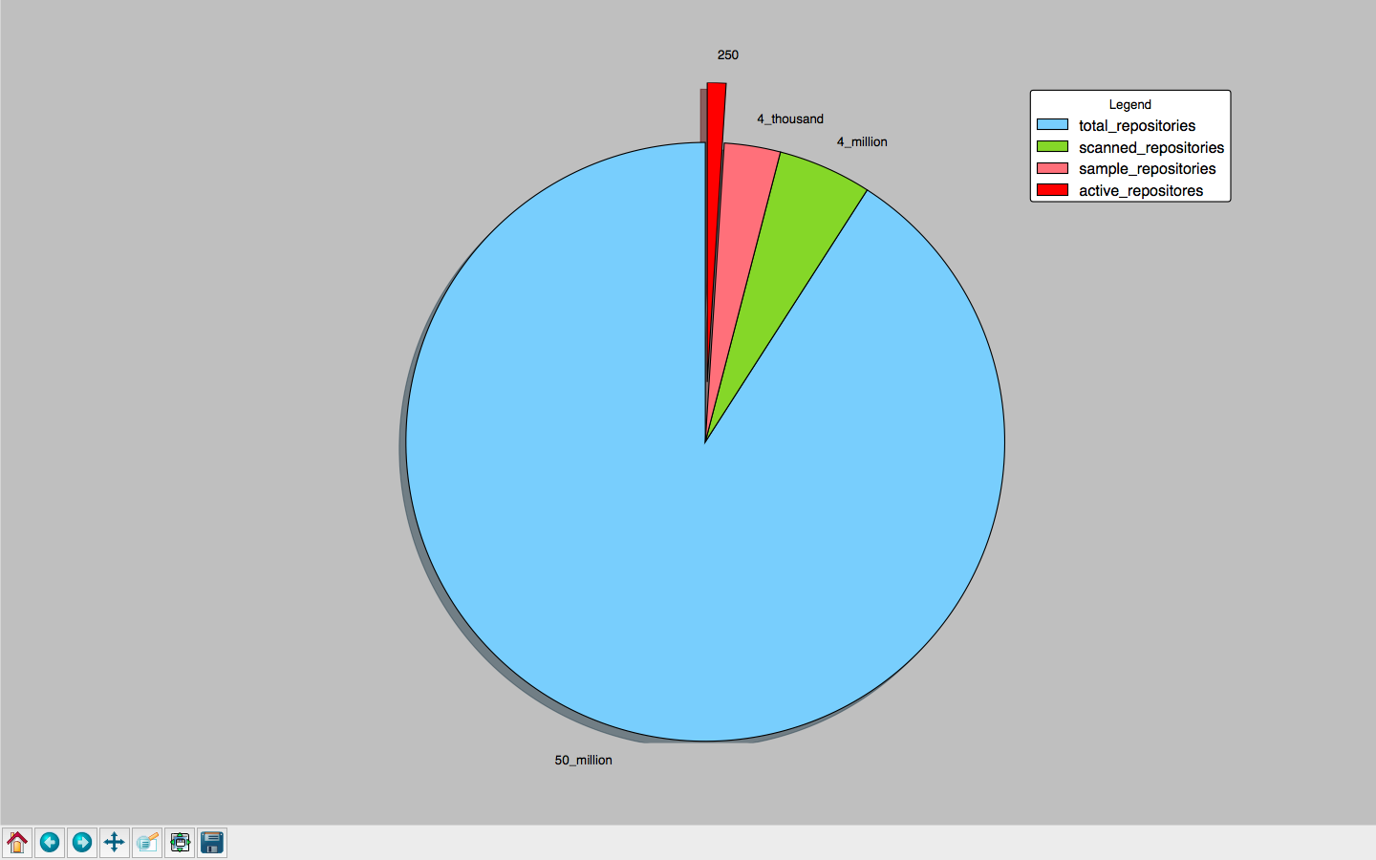

Slide 12
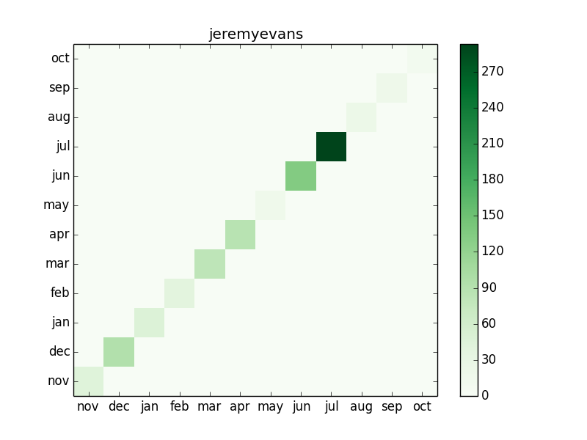

Slide 13
Conclusion
Out of 50 million repositories 4 million repositories were scanned. Out of which 4000 repositories were considered and among which 250 of them were active users.

Slide 14
Future scope
The entire Github repositories can be scanned and active users can be found.
Inactive repositories can be identified and further measures can be taken.

Slide 15
References
Github developers guide

